Slide 1
Chapter 4
Key Distribustion & User Authentication

Slide 2
Outline
Symmetric Key Distritubiton Using Symmeritc Encryption
Kerberos
X.509 Authentication Service
Recommended reading and Web Sites

Slide 3
Authentication
We already defined authentication as
  The correct identification of an entity or a source of data
Two variants
  Data origin authentication (one-way)
  Peer entity authentication (two-way)

Slide 4
Authentication
Data origin authentication
  Verifies source of data.
  Does not protect against modification or duplication of data ( i.e. doesn’t provide integrity)
Peer entity authentication
  Verifies identity of entity with which you’re communicating, usually at connection set-up

Slide 5
Two main approaches
Authentication based on symmetric encryption
  KDC
  Kerberos
Authentication based on certified public keys
  Depends on Digital Certificates & a trust infrastructure
  X.509: hierarchical
  PGP: web of trust

Slide 6
4.1 Key Distribution using Symmeteric Encryption
A key could be selected by A and physically delivered to B.
A third party could select the key and physically deliver it to A and B.
If A and B have previously used a key, one party could transmit the new key to the other, encrypted using the old key.
If A and B each have an encrypted connection to a third party C, C could deliver a key on the encrypted links to A and B.

Slide 7
Key Distribution Center
Two kinds of keys are used
Session key: used btw. 2 end systems in a logical connection called session.
Permanent key: used for distribution session keys.

Slide 8
Operation of a KDC
Suppose. A want to intiate a conn. to B
(1) A→KDC : a request packet
(2) KDC→A : E_{Ka}(Ks)
KDC→B : E_{Kb}(Ks)
(3) A→B: E_{Ks}(M)
(pp.99)

Slide 9

4.2 KERBEROS
In Greek mythology, a many headed dog, the guardian of the entrance of Hades

Slide 10
Kerberos Overview
Users wish to access services on servers.
Three threats exist:
  User pretend to be another user.
  User alter the network address of a workstation.
  User eavesdrop on exchanges and use a replay attack.

Slide 11
Kerberos
Trusted key server system developed by MIT in 1980s
Authentication technique for open distributed systems
Provides a centralized authentication server to authenticate users to servers and servers to users.
Kerberos relies exclusively on symmetric encryption, making no use of public-key encryption
Premise:Kerveros Authentication server knows the passwords of all users and stores these in a centralized database,and shares a unique secret key with each server.(See Page90)

Slide 12
KERBEROS
Provides a centralized authentication server to authenticate users to servers and servers to users.
Relies on conventional encryption, making no use of public-key encryption
Two versions: version 4 and 5
Version 4 makes use of DES

Slide 13
Kerberos Version 4 (See Page 95)
Terms:
  C = Client
  AS = authentication server
  V = server
  IDc = identifier of user on C
  IDv = identifier of V
  P_{c} = password of user on C
  ADc = network address of C
  Kv = secret encryption key shared by AS an V
  TS = timestamp
  || = concatenation

Slide 14
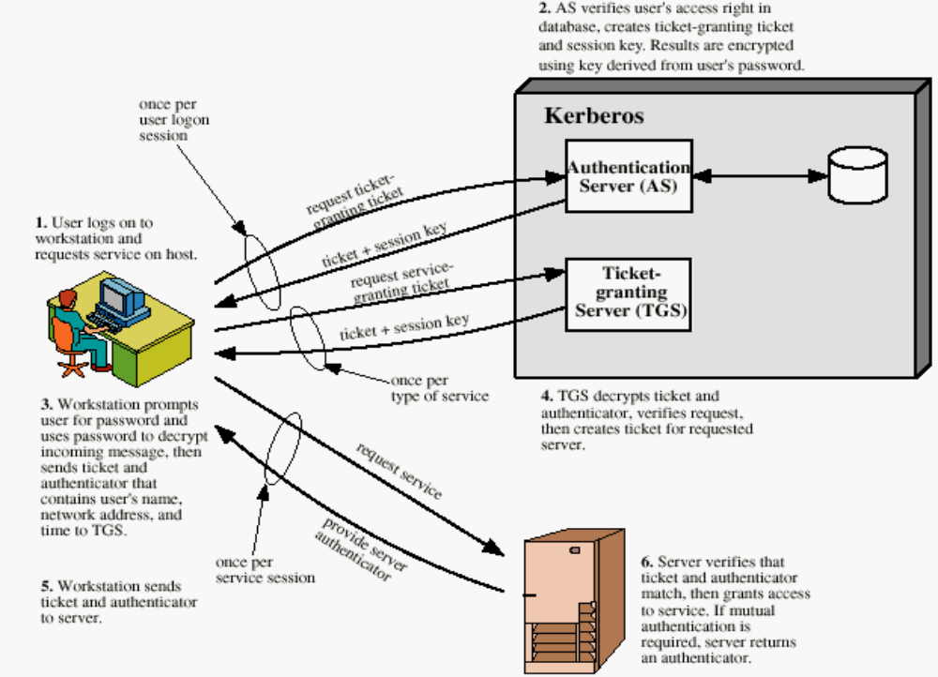
Overview of Kerberos

Slide 15
Version 4 Authentication Dialogue
Authentication Service Exhange: To obtain Ticket-Granting Ticket
C  AS: ID_{c} || ID_{tgs} ||TS1
AS  C: E_{Kc} [K_{c,tgs}|| IDtgs || TS₂ || Lifetime₂ || Tickettgs]
Tickettgs=EK_{tgs}[Kc,tgs||IDC||ADC||IDtgs||TS₂||Lifetime₂]
Message(1)
IDc：Tells AS identity of user from this client
ID_{tgs}: Tells AS that user requests access to TGS
TS1: Allows AS to verify that client’s clock is synchronized with that of AS
Message(2)
E_{kc:}: based on user’s password,enabling AS and client to verify password,and
protecting contents of message(2)
K_{c,tgs}:session key created by AS to permit secure exchange between client
and TGS.
IDtgs:Confirms that this ticket is for the TGS

Slide 16
Ticket-Granting Service Echange: To obtain Service-Granting Ticket
(3) C  TGS: IDv ||Ticket_{tgs} ||Authenticator_{c}
TGS  C: E_{Kc,tgs}[Kc,v ||IDv || TS₄ || Ticketv]
Tickettgs=EK_{tgs}[Kc,tgs||IDC||ADC||IDtgs||TS₂||Lifetime₂]
Ticketv =EKv[Kc,v||IDC||ADC||IDv||TS₄||Lifetime₄]
Authenticator_{c} =E_{Kc,tgs}[IDC||AD_{C}||TS₃]
Client/Server Authentication Exhange: To Obtain Service
(5) C  V: Ticket_{v} || Authenticatorc
V  C: EKc,v[TS₅ +1]
Ticketv =EK_{tgs}[Kc,v||IDC||ADC||IDv||TS₄||Lifetime₄]
Authenticator_{c} = Kc,v[ID_{C}||AD_{C}||TS₅]

Slide 17
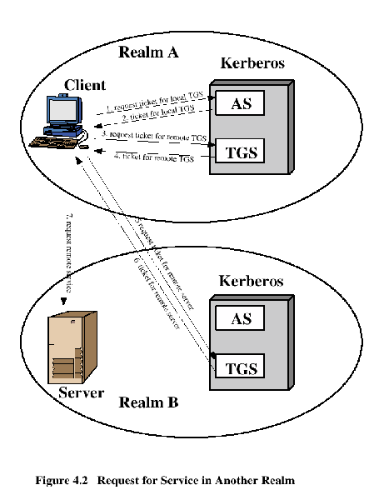
Request for Service in Another Realm

Slide 18
Difference Between Version 4 and 5
Encryption system dependence (V.4 DES)
Internet protocol dependence
Message byte ordering
Ticket lifetime
Authentication forwarding
Interrealm authentication

Slide 19
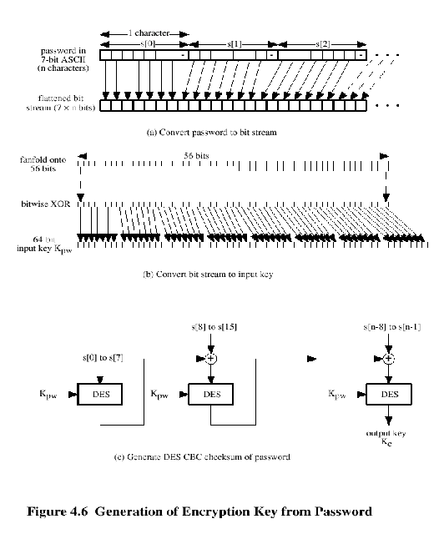
Kerberos Encryption Techniques

Slide 20
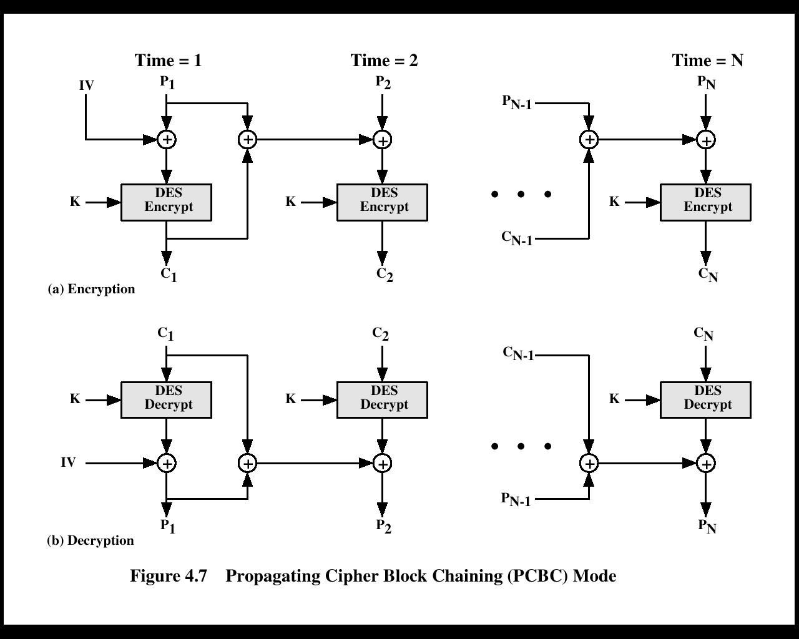
PCBC Mode

Slide 21
Kerberos - in practise
Currently have two Kerberos versions:
4 : restricted to a single realm
5 : allows inter-realm authentication, in beta test
Kerberos v5 is an Internet standard
specified in RFC1510, and used by many utilities
To use Kerberos:
need to have a KDC on your network
need to have Kerberised applications running on all participating systems
major problem - US export restrictions
Kerberos cannot be directly distributed outside the US in source format (& binary versions must obscure crypto routine entry points and have no encryption)
else crypto libraries must be reimplemented locally

Slide 22
4.3 Key Distribution Using Asymmetric Encryption
Based on the use of public-key cryptography and digital signature.
Each certificate contains the public key of a user and is signed with the private key of a CA.
Is used in S/MIME, IP Security, SSL/TLS and SET.
RSA is recommended to use.

Slide 23
Two distinct use
The distribution of public keys
Risk: public key is public, one could pretend to be user A and send a public key to another participant or broadcast such a public key.
The use of public-key to distribute secret keys
Fundamental requirement of conventional encryption is that two participants share a secret key.

Slide 24
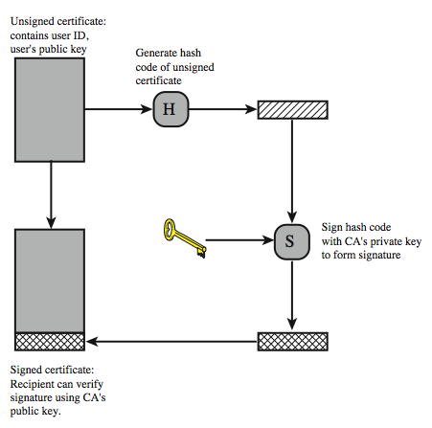
Certificate Used to distribute public key
Notes:
X.509 is based on the use of public-key cryptography and digital signatures. The standard does not dictate the use of a specific algorithm but recommends RSA. The digital signature scheme is assumed to require the use of a hash function. Again, the standard does not dictate a specific hash algorithm. The 1988 recommendation included the description of a recommended hash algorithm; this algorithm has since been shown to be insecure and was dropped from the 1993 recommendation. Stallings Figure 4.3 illustrates the generation of a public-key certificate.

Slide 25
Pulic-key Certification used to distribute secret key
Assume B wants to communicate with A:
B Prepare a message
B Enc. Meg. with one-time session key
B Enc. Session key with A’s public key
B Attach encrypted session key to msg. and send it to A

Slide 26
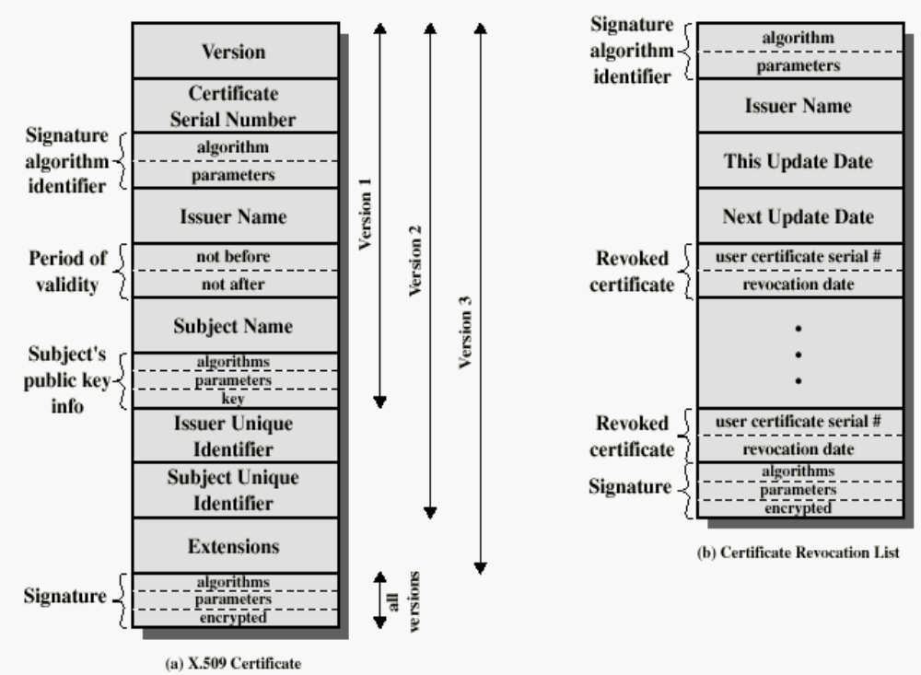
4.4 X.509 Certificate(pp.116)

Slide 27
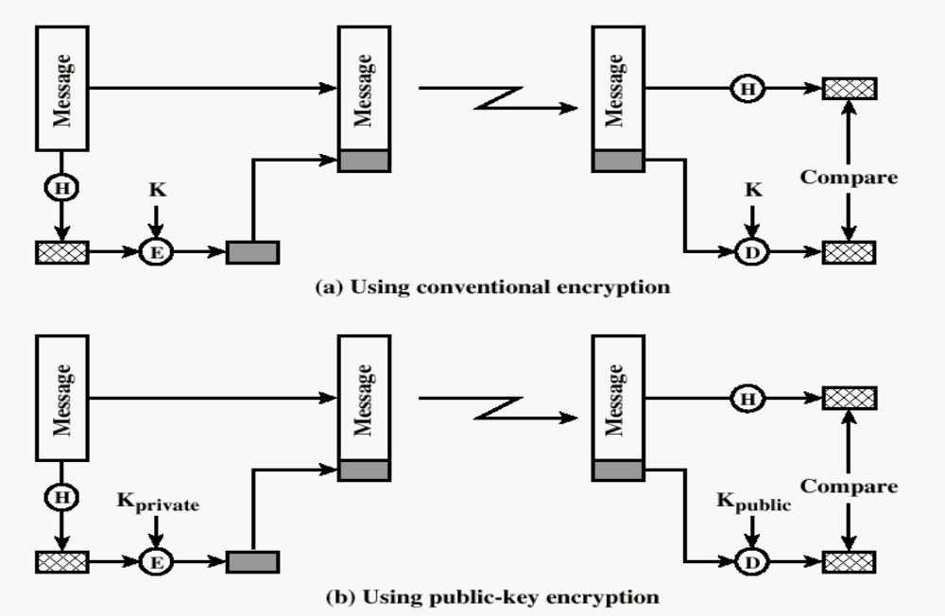
Typical Digital Signature Approach

Slide 28
Obtaining a User’s Certificate
Characteristics of certificates generated by CA:
  Any user with access to the public key of the CA can recover the user public key that was certified.
  No part other than the CA can modify the certificate without this being detected.

Slide 29
CA Hierarchy
if both users share a common CA then they are assumed to know its public key
otherwise CA's must form a hierarchy
use certificates linking members of hierarchy to validate other CA's
  each CA has certificates for clients (forward) and parent (backward)
each client trusts parents certificates
enable verification of any certificate from one CA by users of all other CAs in hierarchy
Notes:
If both parties use the same CA, they know its public key and can verify others certificates. If there is a large community of users, it may not be practical for all users to subscribe to the same CA. With many users, it may be more practical for there to be a number of CAs, each of which securely provides its public key to some fraction of the users. Hence there has to be some means to form a chain of certifications between the CA's used by the two parties, by the use of client and parent certificates. All these certificates of CAs by CAs need to appear in the directory, and the user needs to know how they are linked to follow a path to another user's public-key certificate. X.509 suggests that CAs be arranged in a hierarchy so that navigation is straightforward. It is assumed that each client trusts its parents certificates.

Slide 30
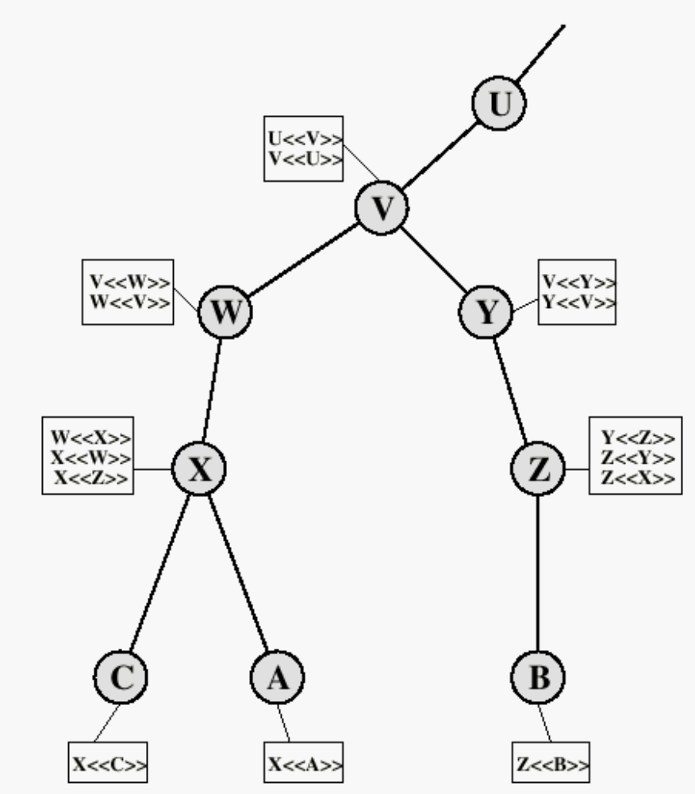
X.509 CA Hierarchy

Slide 31
Revocation of Certificates
certificates have a period of validity
may need to revoke before expiry, eg:
  user's private key is compromised
  user is no longer certified by this CA
  CA's certificate is compromised
CA’s maintain list of revoked certificates
  the Certificate Revocation List (CRL)
users should check certificates with CA’s CRL

Slide 32
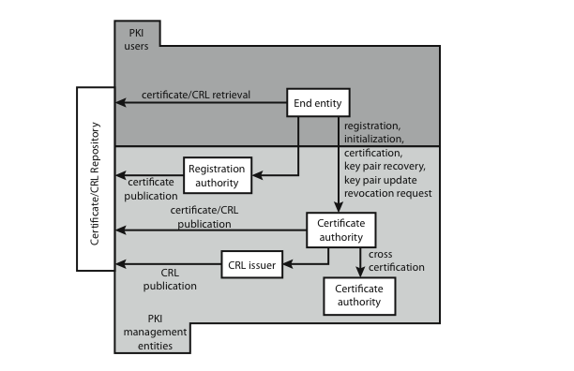
4.5 Public Key Infrastructure
Notes:
RFC 2822 (Internet Security Glossary) defines public-key infrastructure (PKI) as the set of hardware, software, people, policies, and procedures needed to create, manage, store, distribute, and revoke digital certificates based on asymmetric cryptography. Its principal is to enable secure, convenient, and efficient acquisition of public keys. The IETF Public Key Infrastructure X.509 (PKIX) working group has setup a formal (and generic) model based on X.509 that is suitable for deploying a certificate-based architecture on the Internet.
Stallings Figure 4.7 shows interrelationships among some key elements:
• End entity: A generic term used to denote end users, devices (e.g., servers, routers), or any other entity that can be identified in the subject field of a public key certificate. End entities canconsume and/or support PKI-related services.
• Certification authority (CA): The issuer of certificates and (usually) certificate revocation lists (CRLs). It may also support a variety of administrative functions, although these are often delegated to Registration Authorities.
• Registration authority (RA): An optional component that can assume a number of administrative functions from the CA. The RA is often associated with the End Entity registration process, but can assist in a number of other areas as well.
• CRL issuer: An optional component that a CA can delegate to publish CRLs.
• Repository: A generic term used to denote any method for storing certificates and CRLs so that they can be retrieved by End Entities.

Slide 33
PKIX Management
functions:
  registration
  initialization
  certification
  key pair recovery
  key pair update
  revocation request
  cross certification
protocols: CMP, CMC
Notes:
PKIX identifies a number of management functions that potentially need to be supported by management protocols, as shown in Figure 14.16:
• Registration: whereby a user first makes itself known to a CA, prior to issue of a certificate(s) for that user. It usually involves some off-line or online procedure for mutual authentication.
• Initialization: to install key materials that have the appropriate relationship with keys stored elsewhere in the infrastructure.
• Certification: process where a CA issues a certificate for a user's public key, and returns it to the user's client system and/or posts it in a repository.
• Key pair recovery: a mechanism to recover the necessary decryption keys when normal access to the keying material is no longer possible.
• Key pair update: key pairs need to be updated and new certificates issued.
• Revocation request: when authorized person advises need for certificate revocation, e.g. private key compromise, affiliation change, name change.
• Cross certification: when two CAs exchange information used in establishing a cross-certificate, issued by one CA to another CA that contains a CA signature key used for issuing certificates.
The PKIX working group has defines two alternative management protocols between PKIX entities. RFC 2510 defines the certificate management protocols (CMP), which is a flexible protocol able to accommodate a variety of technical, operational, and business models. RFC 2797 defines certificate management messages over CMS (RFC 2630) called CMC. This is built on earlier work to leverage existing code.

Slide 34
4.6 Federated Identity Management
use of common identity management scheme
  across multiple enterprises & numerous applications
  supporting many thousands, even millions of users
principal elements are:
  authentication, authorization, accounting, provisioning, workflow automation, delegated administration, password synchronization, self-service password reset, federation
Kerberos contains many of these elements
Notes:
Federated identity management is a relatively new concept dealing with the use of a common identity management scheme across multiple enterprises and numerous applications and supporting many thousands, even millions of users. Identity management is a centralized, automated approach to provide enterprise-wide access to resources by employees and other authorized individuals, defining an identity for each user (human or process), associating attributes with the identity, and enforcing a means by which a user can verify identity. Its principal elements are:
• Authentication: confirmating user corresponds to the user name provided.
• Authorization: granting access to services/resources given user authentication.
• Accounting: process for logging access and authorization.
• Provisioning: enrollment of users in the system.
• Workflow automation: movement of data in a business process.
• Delegated administration: use of role-based access control to grant permissions.
• Password synchronization: Creating a process for single sign-on (SSO) or reduced sign-on (RSO).
• Self-service password reset: enable user to modify their password
• Federation: process where authentication and permission will be passed on from one system to another, usually across multiple enterprises, reducing the number of authentications needed by the user.
Kerberos contains a number of the elements of an identity management system.

Slide 35
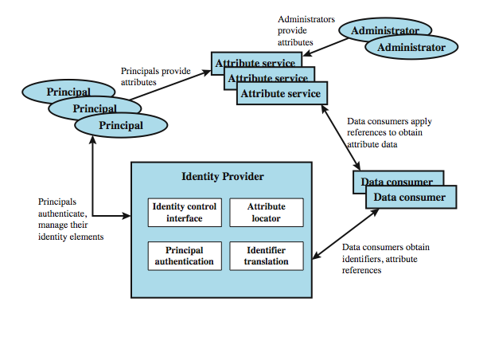
Identity Management
Notes:
Figure 4.8 illustrates entities and data flows in a generic identity management architecture. A principal is an identity holder. Typically, this is a human user that seeks access to resources and services on the network. User devices, agent processes, and server systems may also function as principals. Principals authenticate themselves to an identity provider. The identity provider associates authentication information with a principal, as well as attributes and one or more identifiers.
Increasingly, digital identities incorporate attributes other than simply an identifier and authentication information (such as passwords and biometric information). An attribute service manages the creation and maintenance of such attributes. For example, a user needs to provide a shipping address each time an order is placed at a new Web merchant, and this information needs to be revised when the user moves. Identity management enables the user to provide this information once, so that it is maintained in a single place and released to data consumers in accordance with authorization and privacy policies. Users may create some of the attributes to be associated with their digital identity, such as address. Administrators may also assign attributes to users, such as roles, access permissions, and employee information.
Data consumers are entities that obtain and employ data maintained and provided by identity and attribute providers, often to support authorization decisions and to collect audit information. For example, a database server or file server is a data consumer that needs a client's credentials so as to know what access to provide to that client.

Slide 36
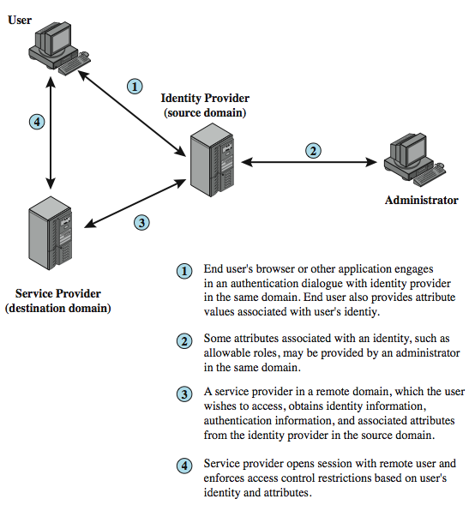
Identity Federation
Notes:
Identity federation is, in essence, an extension of identity management to multiple security domains. Federated identity management refers to the agreements, standards, and technologies that enable the portability of identities, identity attributes, and entitlements across multiple enterprises and numerous applications and supporting many thousands, even millions, of users. Stallings Figure 4.9 illustrates entities and data flows in a generic federated identity management architecture. The identity provider acquires attribute information through dialogue and protocol exchanges with users and administrators. Identity management enables the user to provide this information once, so that it is maintained in a single place and released to data consumers in accordance with authorization and privacy policies. Service providers are entities that obtain and employ data maintained and provided by identity providers, often to support authorization decisions and to collect audit information. A service provider can be in the same domain as the user and the identity provider. The power of this approach is for federated identity management, in which the service provider is in a different domain.

Slide 37
Standards Used
Security Assertion Markup Language (SAML)
  XML-based language for exchange of security information between online business partners
part of OASIS (Organization for the Advancement of Structured Information Standards) standards for federated identity management
  e.g. WS-Federation for browser-based federation
need a few mature industry standards
Notes:
Federated identity management uses a number of standards as the building blocks for secure identity exchange across different domains or heterogeneous systems. In essence, organizations issue some form of security tickets for their users that can be processed by cooperating partners. Identity federation standards are thus concerned with defining these tickets, in terms of content and format, providing protocols for exchanging tickets and performing a number of management tasks. These tasks include configuring systems to perform attribute transfers and identity mapping, and performing logging and auditing functions. The principal underlying standard for federated identity is the Security Assertion Markup Language (SAML), which SAML is an XML-based language that defines the exchange of security information between online business partners. SAML conveys authentication information in the form of assertions about subjects. Assertions are statements about the subject issued by an authoritative entity.
SAML is part of a broader collection of standards being issued by OASIS (Organization for the Advancement of Structured Information Standards) for federated identity management. For example, WS-Federation enables browser-based federation; it relies on a security token service to broker trust of identities, attributes, and authentication between participating Web services. The challenge with federated identity management is to integrate multiple technologies, standards, and services to provide a secure, user-friendly utility. The key, as in most areas of security and networking, is the reliance on a few mature standards widely accepted by industry. Federated identity management seems to have reached this level of maturity.

Slide 38
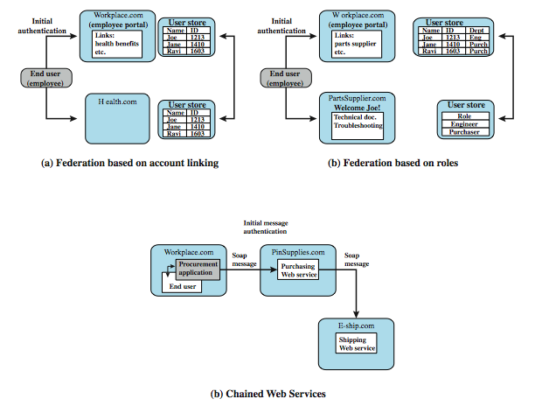
Federated Identity Examples
Notes:
To get some feel for the functionality of identity federation, we look at three scenarios, taken from [COMP06] (more details in text).
In the first (Figure 4.10a), Workplace.com contracts with Health.com to provide employee health benefits. An employee signs on and authenticates to Workplace.com. The two organizations federated and cooperatively exchanges user identifiers. Health.com maintains user identities for every employee at Workplace.com and associates with each identity health benefits info & access rights.
Figure 4.10b shows another browser-based scheme. PartsSupplier.com is a regular supplier of parts to Workplace.com. A role-based access control (RBAC) scheme is used. An engineer of Workplace.com authenticates to Workplace.com and clicks on a link to access information at PartsSupplier.com. For this scenario, PartSupplier.com does not have identity information for individual employees at Workplace.com. Rather, the linkage between the two federated partners is in terms of roles.
The scenario in Figure 4.10c can be referred to as document-based. Workplace.com has a purchasing agreement with PinSupplies.com which has a business relationship with E-Ship.com. An employee of WorkPlace.com signs on and is authenticated to make purchases. The procurement application generates an XML/SOAP order document, and inserts into the header the user's credentials and Workplace.com's organizational identity. It then posts the message to the PinSupplies.com's purchasing Web service. This service authenticates the incoming message and processes the request, sending a SOAP message to its shipping partner to fulfill the order.

